Slide 1

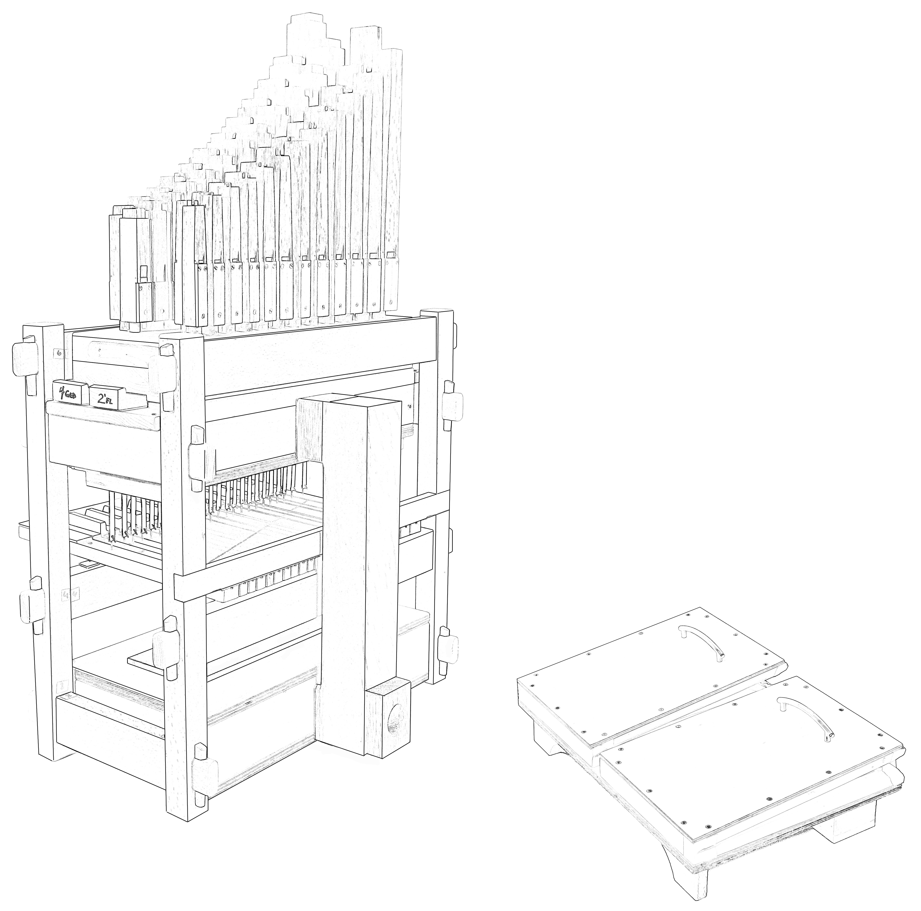
Name:___________________
Notes:
1) 4' oak gedacht - mid western white oak - quarter sawn , figured
2) 2' oak flute - Appalachian white oak south east USA , quarter sawn , figured
3) front pipe caps - Sapele (sa-pel-a) tropical Africa
4) key sharps & tusks - west African ebony
5) frame parts - European Beech
6) key naturals - Eastern "rock hard" maple
7) key levers, toe board and feeder bellows bottom manifold - cherry USA
8) all plywood components - Baltic Birch ( Balkans) or Appleply USA
9) the tracker tabs are reinforced neoprene 1/6"thick (PS still looking for a similar product in a different color)

Slide 2
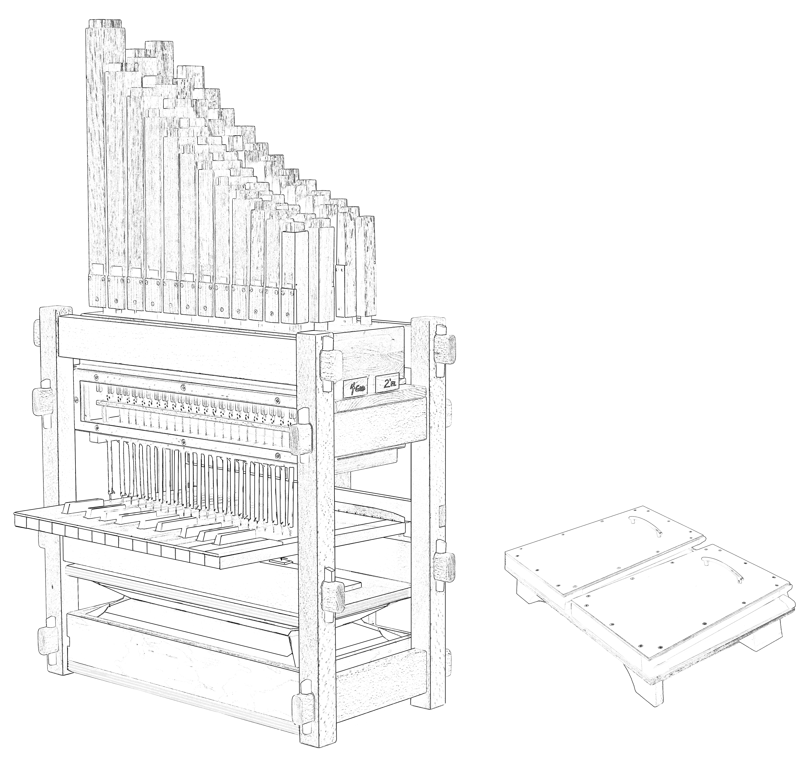
Notes:
1) 4' oak gedacht - mid western white oak - quarter sawn , figured
2) 2' oak flute - Appalachian white oak south east USA , quarter sawn , figured
3) front pipe caps - Sapele (sa-pel-a) tropical Africa
4) key sharps & tusks - west African ebony
5) frame parts - European Beech
6) key naturals - Eastern "rock hard" maple
7) key levers, toe board and feeder bellows bottom manifold - cherry USA
8) all plywood components - Baltic Birch ( Balkans) or Appleply USA
9) the tracker tabs are reinforced neoprene 1/6"thick (PS still looking for a similar product in a different color)

Slide 3
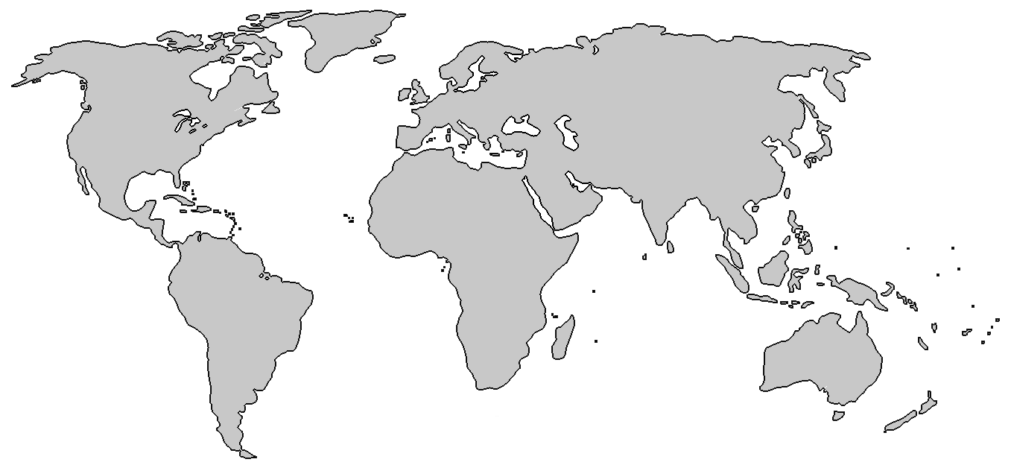
1
4’ capped pipes:
2
Front pipe caps:
3
2’ open pipes:
4
Frame:
1
5
1
www.OrgelkidsUSA.org
Notes:
1) 4' oak gedacht - mid western white oak - quarter sawn , figured Quercus alba
2) 2' oak flute - Appalachian white oak south east USA , quarter sawn , figured
3) front pipe caps - Sapele (sa-pel-a) tropical Africa ‎Entandrophragma cylindricum
4) key sharps & tusks - west African ebony Diospyros crassiflora
5) frame parts - European Beech Fagus sylvatica
6) key naturals - Eastern "rock hard" maple Acer (saccharum?)
7) key levers, toe board and feeder bellows bottom manifold - cherry USA Prunus (serotina?)
8) all plywood components - Baltic Birch ( Balkans) or Appleply USA
9) the tracker tabs are reinforced neoprene 1/6"thick (PS still looking for a similar product in a different color)

Slide 4
Wood Origins & Species
4
1
3
5
1
4’ capped pipes:
6
Midwestern white oak
2
Quercus alba
7
2
Front pipe caps:
Sapele
3
2’ open pipes:
Appalachian white oak
Entandrophragma cylindricum
4
Frame:
Quercus alba
European beech
Fagus sylvatica
6
Natural key covers:
Eastern “rock hard” maple
5
Key levers, toe board:
Genus: Acer
Cherry
Genus: Prunus
7
Tusks & black keys:
Ebony
Diospyros crassiflora
Notes:
1) 4' oak gedacht - midwestern white oak - quarter sawn , figured Quercus alba
2) front pipe caps - Sapele (sa-pel-a) tropical Africa ‎Entandrophragma cylindricum
3) 2' oak flute - Appalachian white oak south east USA , quarter sawn , figured
4) frame parts - European Beech Fagus sylvatica
5) key levers, toe board and feeder bellows bottom manifold - cherry USA Prunus (serotina?)
6) key naturals - Eastern "rock hard" maple Acer (saccharum?)
7) key sharps & tusks - west African ebony Diospyros crassiflora
8) all plywood components - Baltic Birch ( Balkans) or Appleply USA
9) the tracker tabs are reinforced neoprene 1/6"thick (PS still looking for a similar product in a different color)

Slide 5
Wood Origins & Species
4
1
3
5
1
4’ capped pipes:
6
Midwestern white oak
2
Quercus alba
7
2
Front pipe caps:
Sapele
3
2’ open pipes:
Appalachian white oak
Entandrophragma cylindricum
4
Frame:
Quercus alba
European beech
Fagus sylvatica
6
Natural key covers:
Eastern “rock hard” maple
5
Key levers, toe board:
Genus: Acer
Cherry
Genus: Prunus
7
Tusks & black keys:
Ebony or African blackwood
Diospyros crassiflora or Dalbergia melanoxylon (used in clarinets)
Notes:
1) 4' oak gedacht - midwestern white oak - quarter sawn , figured Quercus alba
2) front pipe caps - Sapele (sa-pel-a) tropical Africa ‎Entandrophragma cylindricum
3) 2' oak flute - Appalachian white oak south east USA , quarter sawn , figured
4) frame parts - European Beech Fagus sylvatica
5) key levers, toe board and feeder bellows bottom manifold - cherry USA Prunus (serotina?)
6) key naturals - Eastern "rock hard" maple Acer (saccharum?)
7) key sharps & tusks - west African ebony Diospyros crassiflora
Alternatively, Christo uses african blackwood or grendilla, also used in clarinets. Dalbergia melanoxylon
8) all plywood components - Baltic Birch ( Balkans) or Appleply USA
9) the tracker tabs are reinforced neoprene 1/6"thick (PS still looking for a similar product in a different color)

Slide 6
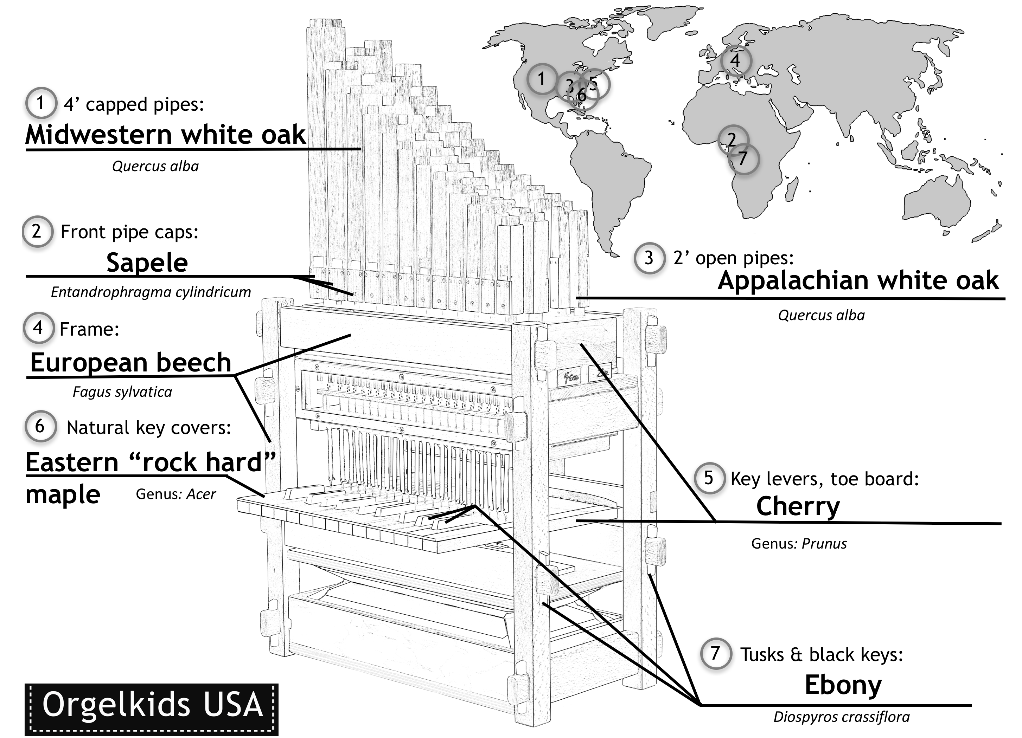
Wood Origins & Species

